Slide 1
Monitoring & Tuning
Week-6
Platforms and applications require monitoring and tuning to manage issues that inevitably happen. In this module you'll learn about connecting the Apache Spark user interface web server and using the same UI web server to manage application processes. Identify common Apache Spark application issues. Learn about debugging issues using the application UI and locating related log files. Discover and gain real-world knowledge about how Spark manages memory and processor resources via videos and in the available hands-on lab.
Learning Objectives
Connect to the Apache Spark user interface web server and navigate the Spark user interface.
Define parts of the Apache Spark application workflow, use UI webserver to monitor application progress, and describe a sample UI workflow.
Identify common Apache Spark application issues, debug issues using the application UI, and locate and read related log files.
Describe Apache Spark memory parameters, memory management, and data persistence.
Set executor memory on submit and configure executor memory and cores for Spark Standalone.
Explain how Apache Spark uses processor cores and how to use Spark to configure cores for an application.
Start a Spark Standalone Cluster and connect with the PySpark shell.
Create a DataFrame in PySpark shell and open the Spark Application web UI.
Debug a runtime error by locating a failed task in the Spark Application web UI.
Run an SQL query to monitor application performance, then scale up by adding another worker to the Spark Standalone cluster.

Slide 2
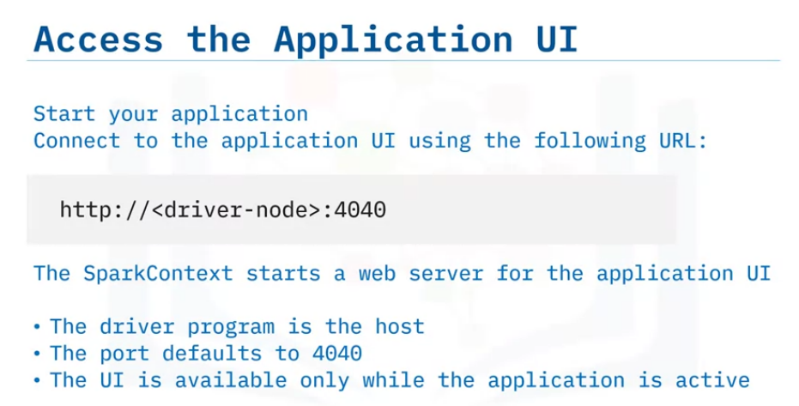
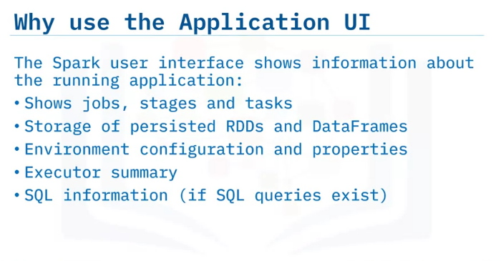
The Apache Spark User Interface
Explain how to connect to the Apache Spark user interface web server;
navigate basic elements of the Spark user interface
When a Spark application is being run, as the driver program creates a SparkContext, Spark starts a web server that serves as the application user interface.
You can connect to the UI webserver by entering the hostname of the driver followed by port 4040 in a browser once that application is running.
The web server runs for the duration of the Spark application, so once the SparkContext stops, the server shuts down and the application UI is no longer accessible.
The Spark user interface provides valuable insights, organized on multiple tabs, about the running application.
The Jobs tab displays the application’s jobs, including job status.
The Stages tab reports the state of tasks within a stage.
The Storage tab shows the size of any RDDs or DataFrames that persisted to memory or disk.
The Environment tab information includes any environment variables and system properties for Spark or the JVM.
The Executor tab displays a summary that shows memory and disk usage for any executors in use for the application.
Additional tabs display based on the type of application in use.
For example, if the application performs SQL queries, the SQL tab displays and shows metrics for each query.

Slide 3
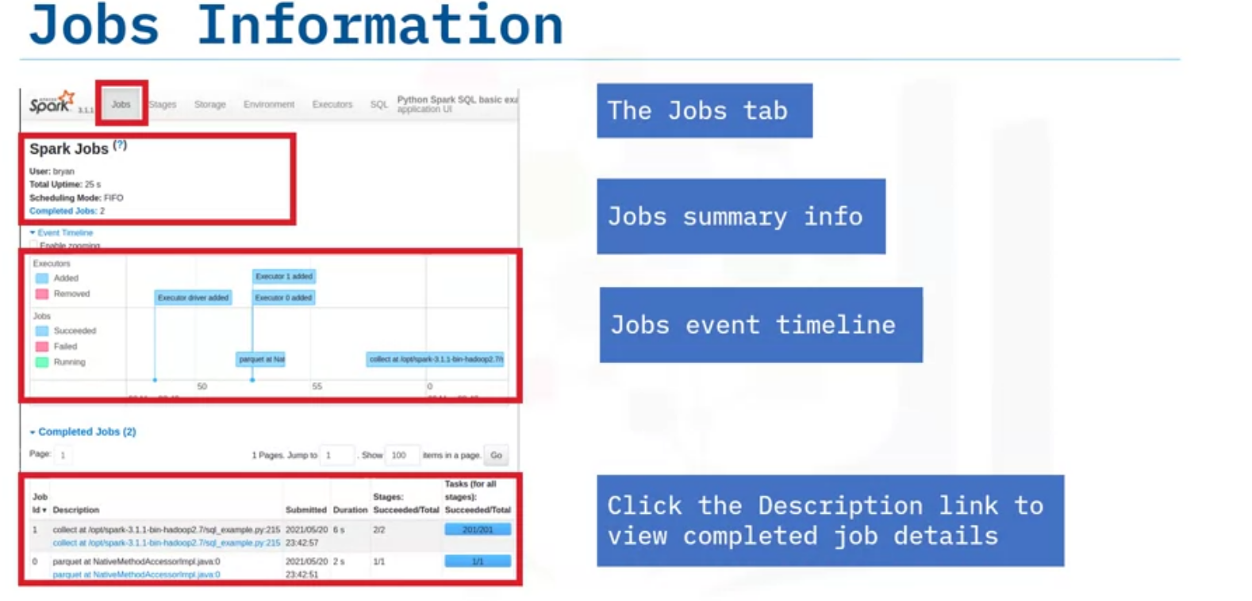
The top of the window displays the event timeline and shows when the driver and executor processes start and when the jobs are created.
In this example, the application has completed two jobs.
These two jobs appear in the list at the bottom which also has additional job-related information such as duration, number of stages, and number of total tasks for all stages. The job list also displays Description hyperlinks to view the job details.
Now let’s view Job Details for information about the different stages of a specific job

Slide 4
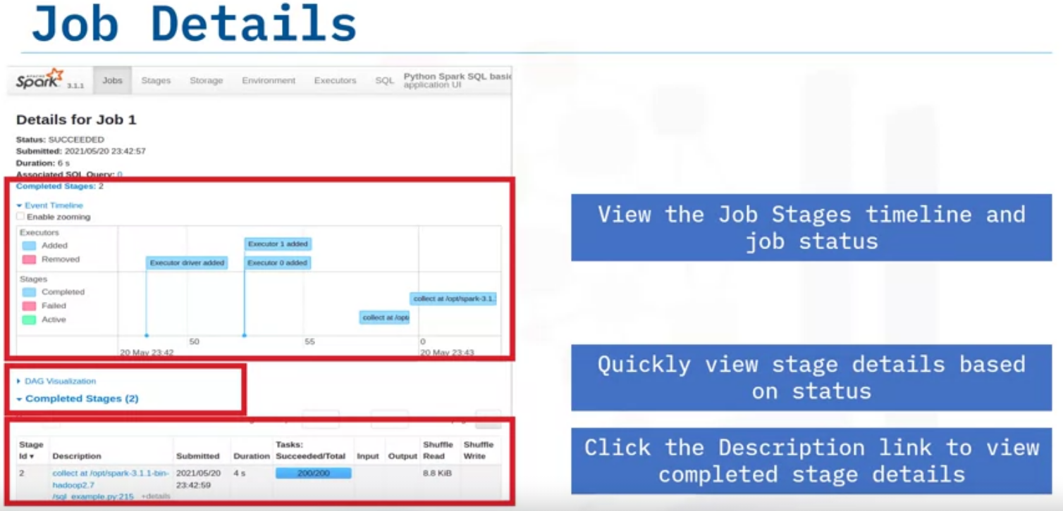
The timeline displays each stage, where you can quickly see the job’s timing and duration.
Below the timeline display you’ll see Completed Stages.
In the parentheses beside the heading, you’ll see a quick view that displays the number of completed stages.
Then, view the list of the stages within the job and job metrics including when the job was submitted, input/output sizes, the number of attempted tasks, the number of succeeded tasks, and how much data was read or written because of a shuffle.
This example shows two stages separated by a shuffle.
So, stage one wrote shuffle data and stage two read that data.
To view more details about specific stage within a job, click the Stage ID Description hyperlinks.

Slide 5
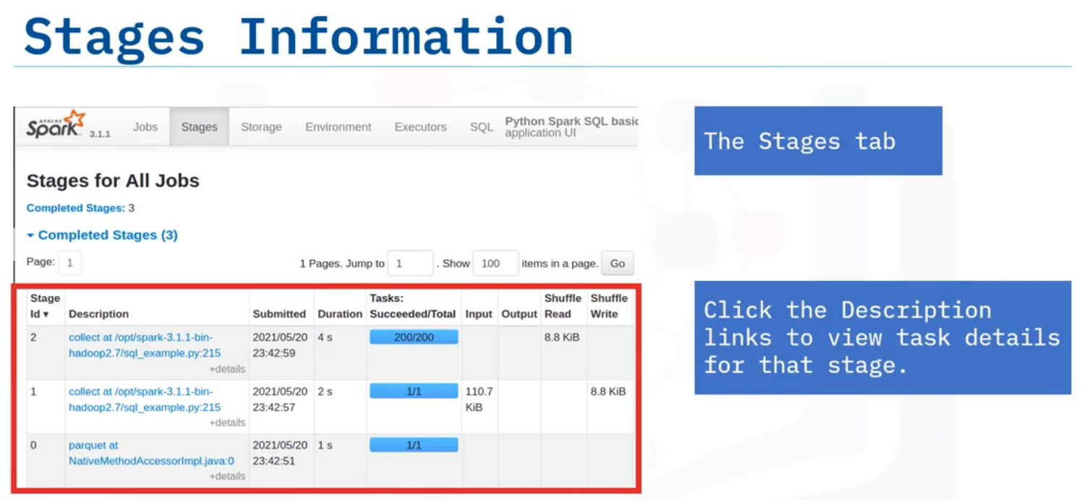
The Stages tab shows a list of all stages in the application, grouped by the current state of either completed, active, or pending.
This example displays three completed stages.
Click the Stage ID Description hyperlinks to view task details for that stage.

Slide 6
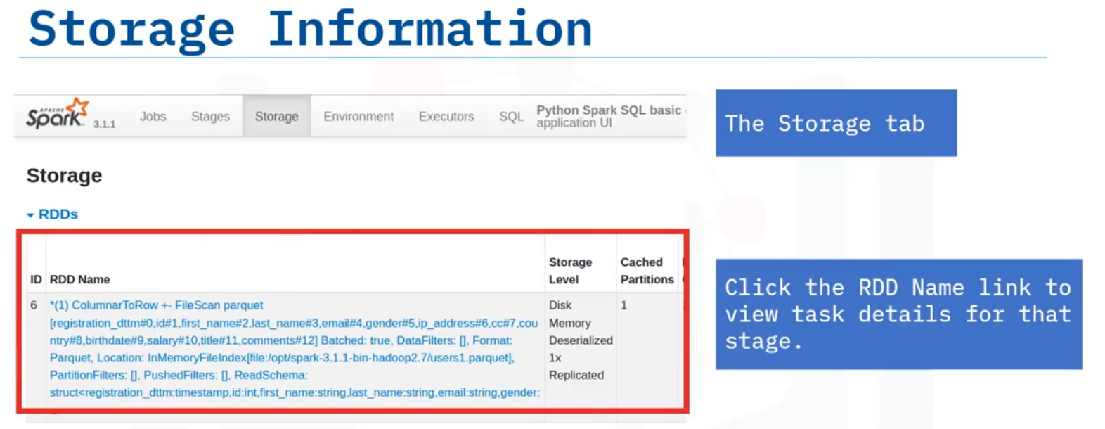
The Storage tab displays details about RDDs that have been cached, or persisted, to memory and/or written to disk.
This example image shows one RDD that’s been cached to memory only.

Slide 7
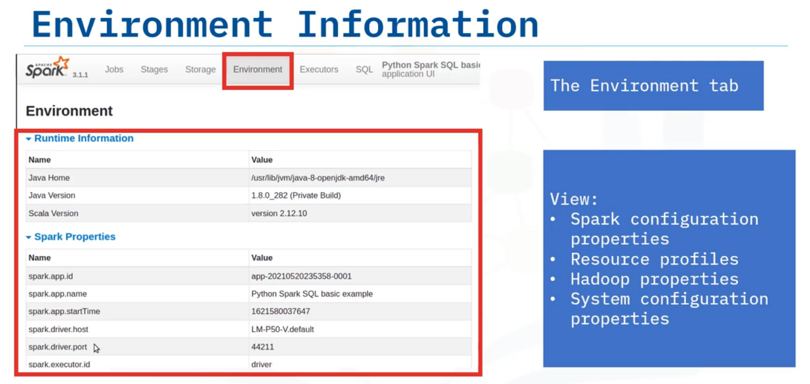
The Environment tab has several lists to describe the environment of the running application.
These lists include the Spark configuration properties and resource profiles, as well as properties for Hadoop and the current system properties.

Slide 8
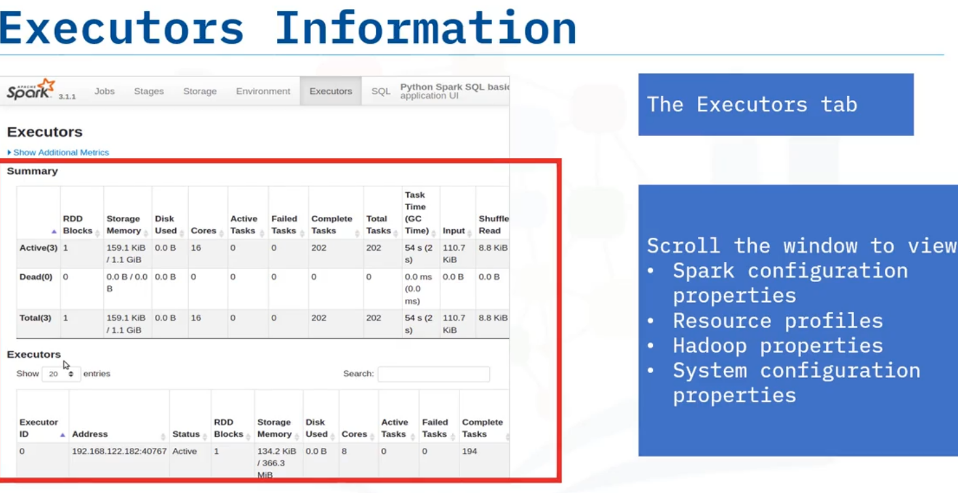
The Executors tab displays a summary table at the top that shows metrics on all active or dead executors, along with a full range of metrics on the task numbers, data I/O, disk, and memory usage.
At the bottom is a list of all executors, including the driver, that have been in use during the application, again with a full range of metrics.
This list also provides links to the stdout and stderror log messages of the executor process

Slide 9
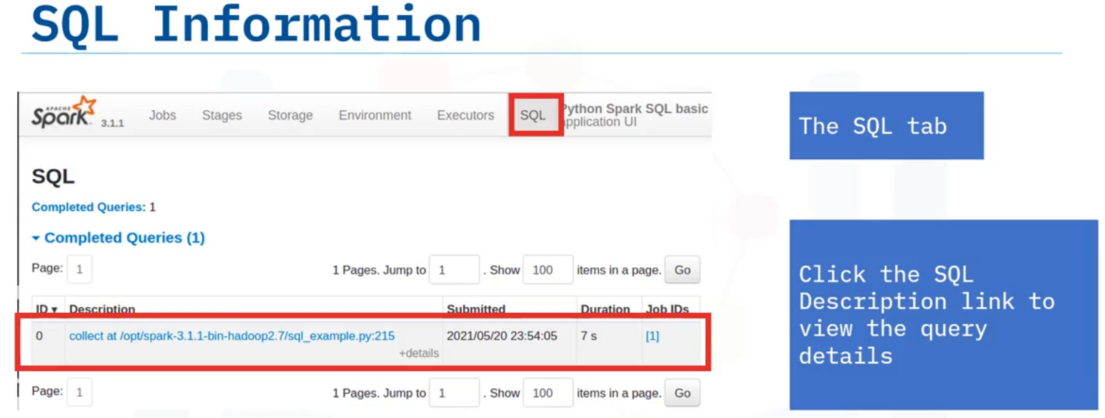
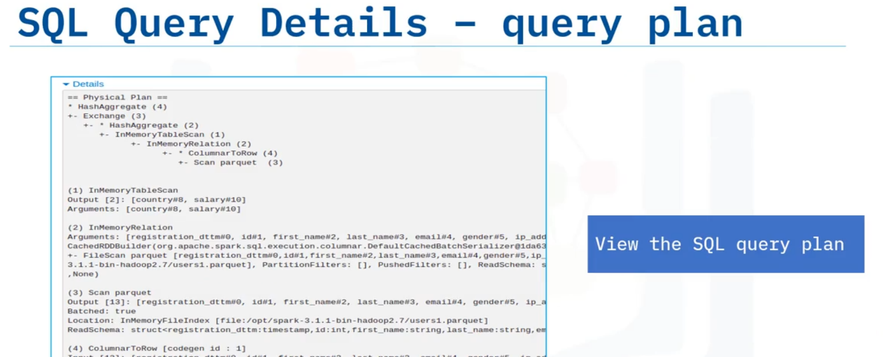
If the application runs SQL queries, the UI displays and populates the SQL tab.
Click the SQL Description hyperlink to display the query’s details.
You can view the SQL query plan when you click the Details expander arrow.

Slide 10
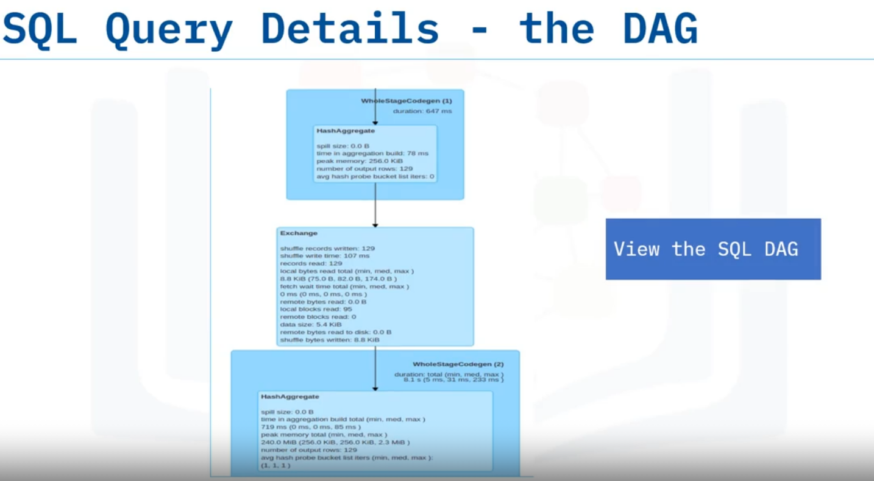
You can also view the query’s DAG including the logical physical plans as determined by the optimizer.

Slide 11
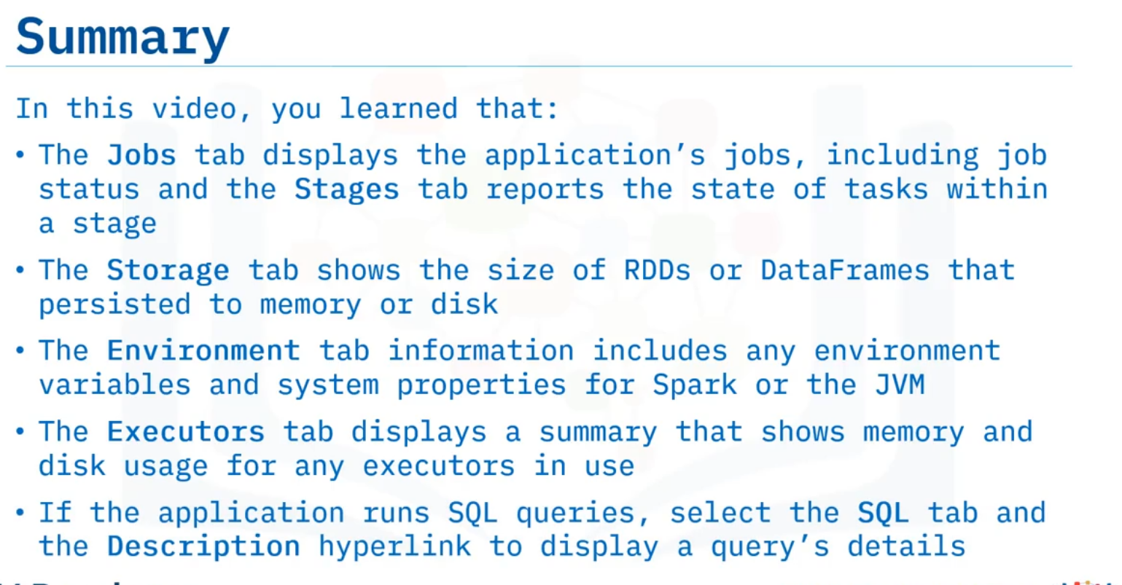

Slide 12
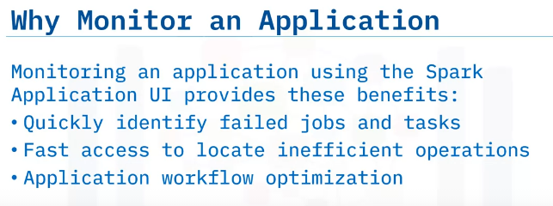
Monitoring Application Progress
Define parts of the application workflow,
utilize the UI webserver to monitor application progress,
describe a sample workflow from the UI
Running a Spark application can sometimes take a long time and have many possible points of failure.
When an issue arises, say a faulty worker node is causing the occasional task to fail, it is essential to find and address the problem quickly, so that cluster resources do not stay idle.
The Spark Application UI is a great way to monitor a running application.
The application UI centralizes critical information, including status information, and organizes information logically, resulting in convenient and fast access.
You can quickly identify failures, then drill down to the lowest levels of the application to find out the root causes of failures.
Besides failures, the UI can also help you quickly locate and analyze application processing bottlenecks

Slide 13
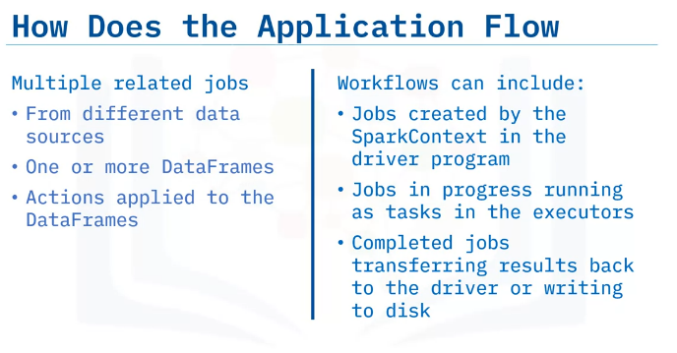
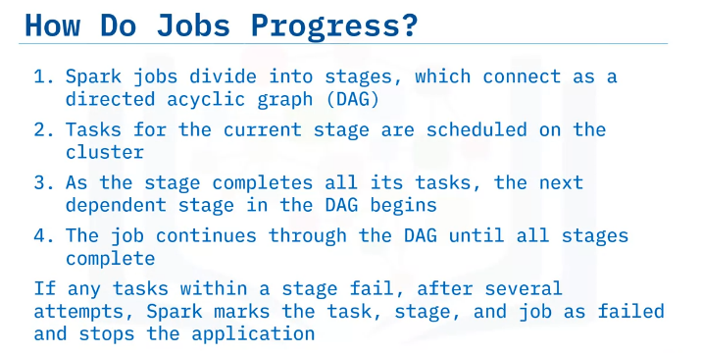
A Spark application can consist of many parallel, and often, related jobs, including multiple jobs resulting from multiple data sources, multiple DataFrames, and the actions applied to the DataFrames.
Workflows can include:
Jobs created by the SparkContext in the driver program,
jobs in progress running as tasks in the executors, and
completed jobs transferring results back to the driver or writing to disk.
First, Spark jobs divide into stages, which connect as a Directed Acyclic Graph, or DAG.
Tasks for the current stage are scheduled on the cluster.
When the stage completes all of its tasks, the next dependent stage in the DAG begins.
The job progresses through the DAG all stages are completed.
If any of the tasks within a stage fail, after several attempts, Spark marks the task, stage, and job as failed and stops the application.

Slide 14
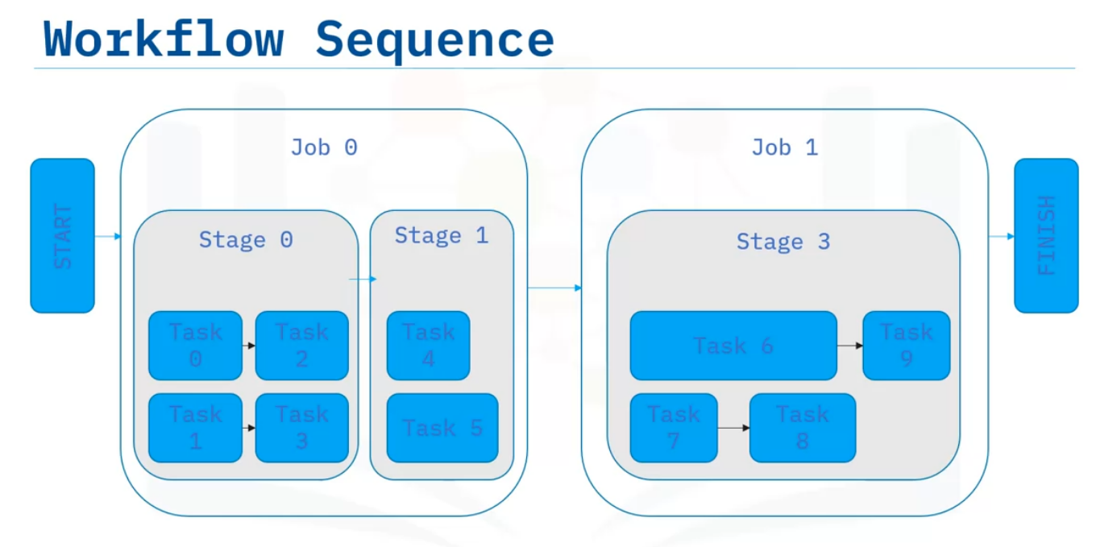
example.: The application first creates a job.
Next, Spark divides the job into one or more stages.
The first stage, Stage "0," has no dependencies, so Spark sends its tasks to the executors. Stage "0" now has two tasks started.
The width of the task indicates the elapsed run time.
Two more tasks that are dependent on “0” and “1” run, but do not require a shuffle, such as map operations, for example, so they remain part of Stage “0” and run independently.
The end of Stage "0" now marks the beginning of the next Stage "1."
This boundary exists because a shuffle was required, which means that all tasks for Stage “1” must wait for all tasks in Stage “0” to finish before starting.
Here you can see that tasks 4 and 5 have different run times.
Their run times differ because each task is running independently and on different data partitions.
However, the stage is not complete until all tasks have finished.
With this job completed, Spark can begin a new job.
In this example, Job 1 depends on the data from Job 0.
The next job consists of one stage and starts Tasks 6 and 7.
Since tasks within a stage can run independently, when Task 7 completes, the executor running Task 7 can immediately start Task 8 while Task 6 continues to run.
When the application completes Tasks 8 and 9, the stage and job are complete, marking the end of this application workflow.

Slide 15
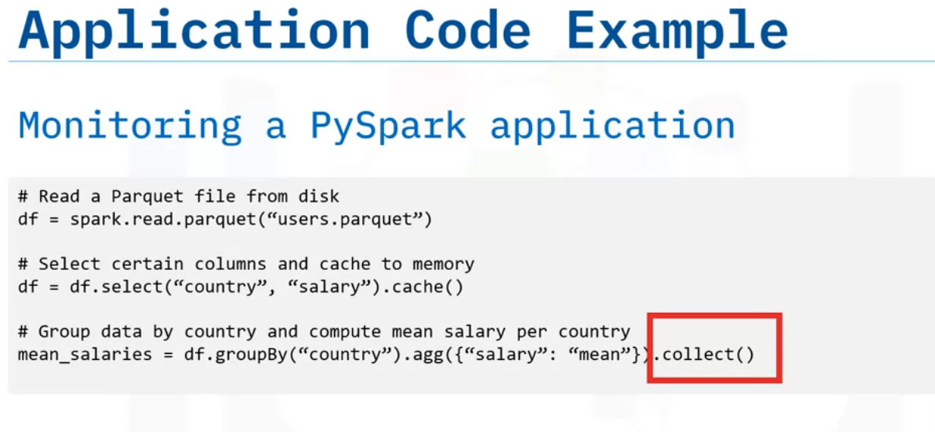
Next, view this example application to see how the code translates to a workflow you can monitor using the UI.
This application’s single data source is a Parquet file loaded from disk to produce a DataFrame.
Using that same DataFrame, two columns are selected.
The caching action is specific to this example.
The application groups the data by the "country" column and then aggregates the data by calculating the mean of the "salary" column.
Next the “collect” action runs.
This action triggers the job creation and schedules the tasks, as the previous operations are all lazily computed.

Slide 16
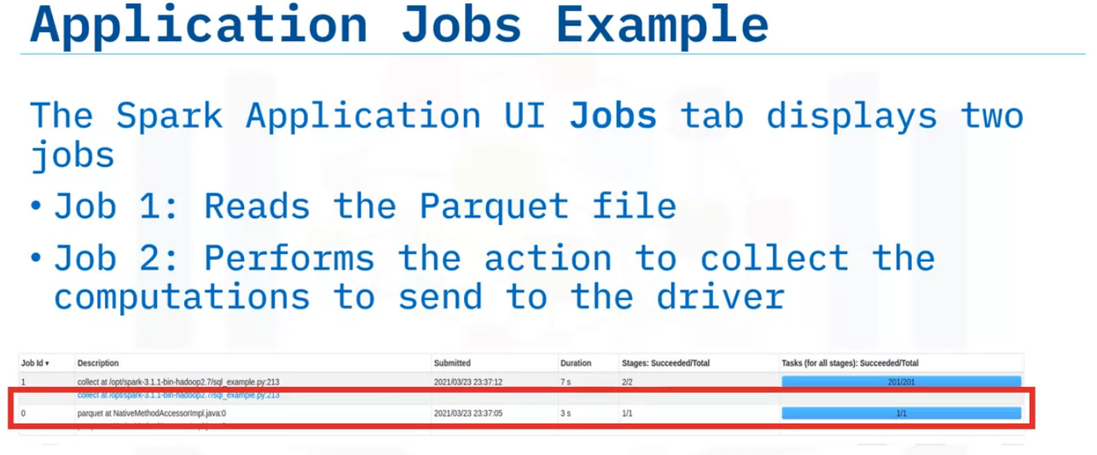
After you submit the application, start the Spark Application UI and view the Jobs tab, which displays two jobs.
One job reads the Parquet file from disk.
The second job is the result of the action to collect the grouped aggregate computations to send to the driver

Slide 17
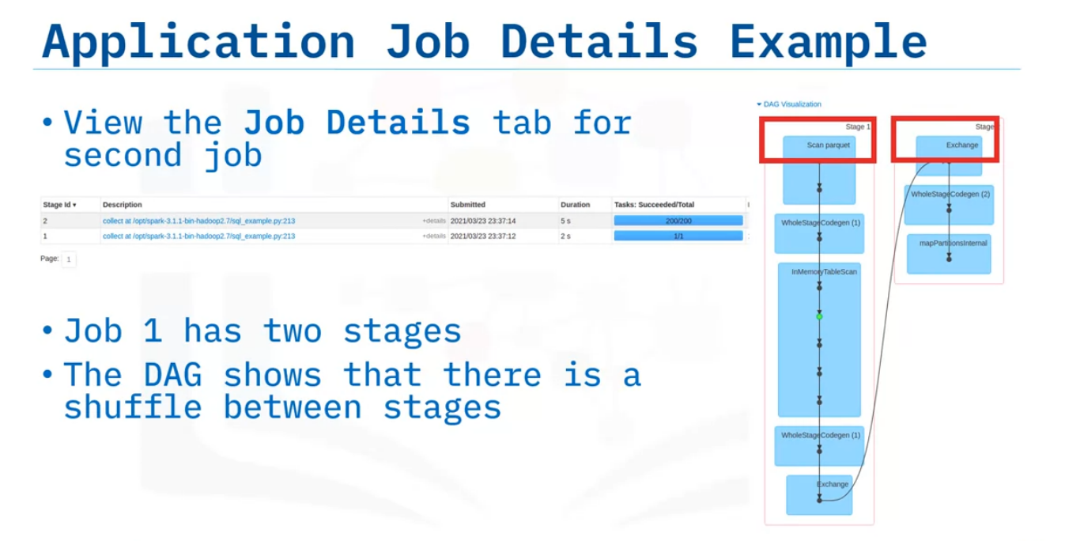
On the Jobs tab, click a specific job to display its Job Details page.
Here you can see the number of stages and the DAG that links the stages.
This example has two stages connected by a shuffle exchange, which is due to grouping the data by country in the application.

Slide 18
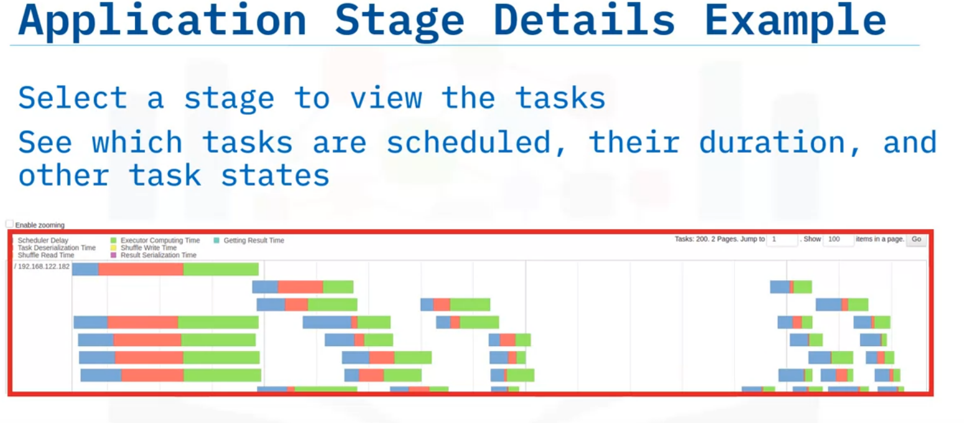
Select a stage to view the tasks.
The Stage Details timeline indicates each task’s state using color coding.
View the timeline to see when each task was started and the task’s duration.
Use this information to quickly locate failed tasks, see which tasks are taking a long time to run, and determine how well your application is parallelized

Slide 19
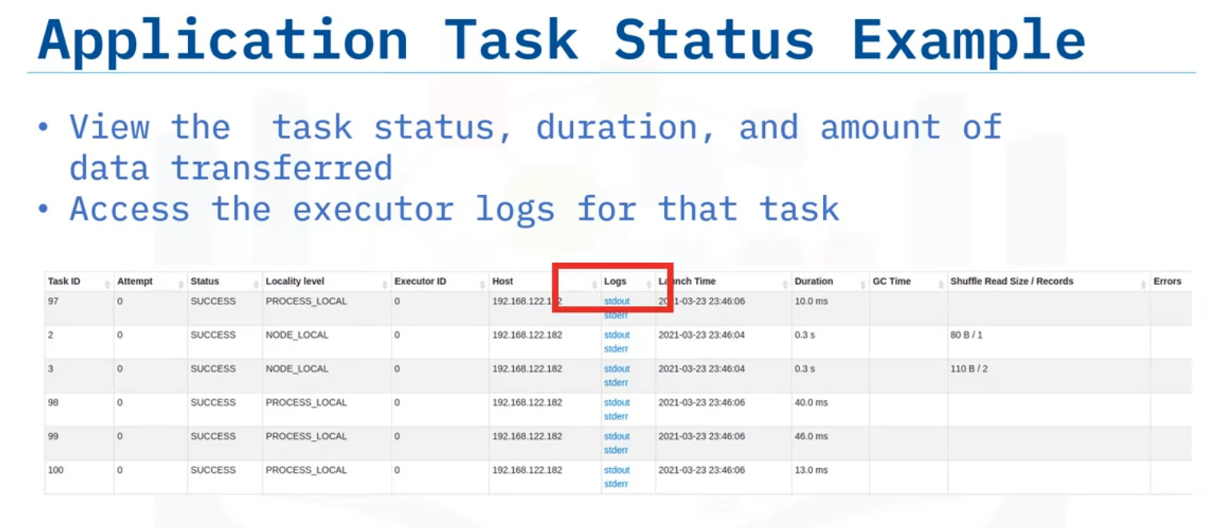
The task list provides even more metrics, including status, duration, and amount of data transferred as part of a shuffle.
Here, you see two tasks that read one and two records as part of a shuffle.
You see these two tasks because, by default for a shuffle, Spark repartitions the data into a larger number of partitions.
You can also access a task’s executor logs.
The data used in this example is small.
Therefore, many tasks only have a small number of records to process.

Slide 20
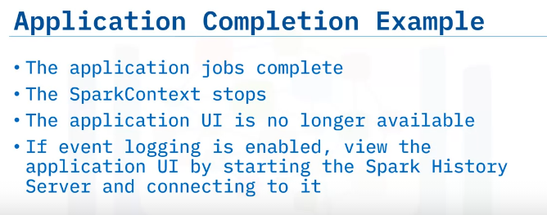
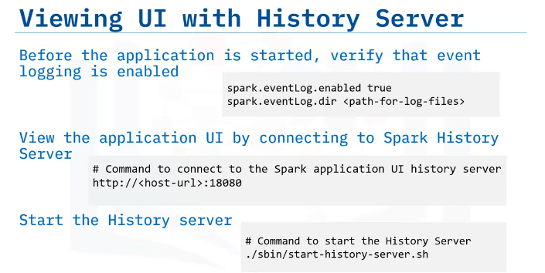
When all application jobs are complete and the results are sent to the driver or written to disk, the SparkContext can be stopped either manually or automatically when the application exits.
When the application UI server shuts down the UI is no longer available.
To view the Application UI after the application stops, event logging must be enabled.
This means that all events in the application workflow are logged to a file, and the UI can be viewed with the Spark History server.
To view the Application UI with the History Server, first verify that event logging is enabled.
Enter the event log path as seen using the properties displayed onscreen before submitting the application.
When the application completes, the Application UI populates the log files in the event log directory.
To start the history server, apply the command shown onscreen.
Once the history server is started, connect to the history server by typing the history server host URL followed by the default port number 18080.
You can see a list of completed applications and select one to view its application UI.

Slide 21
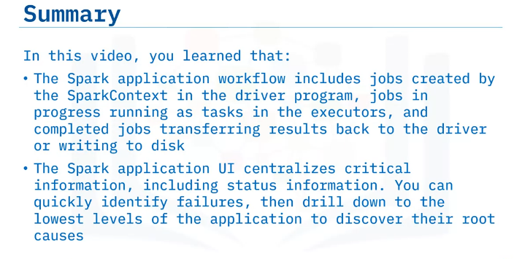

Slide 22
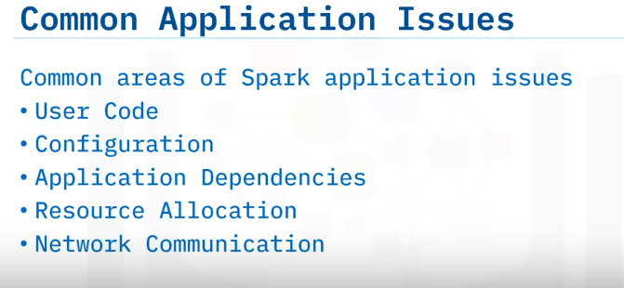
Identify common Apache Spark application issues,
debug issues through the application UI,
describe application log file locations and content.
Debugging Apache Spark Application Issues
Running a Spark application on a cluster is a complex process with many working parts and many ways in which an application can fail.
Common reasons for application failure on a cluster include user code, system and application configurations, application dependencies that are missing or an incorrect version, improper resource allocation, and network communication among cluster nodes.

Slide 23
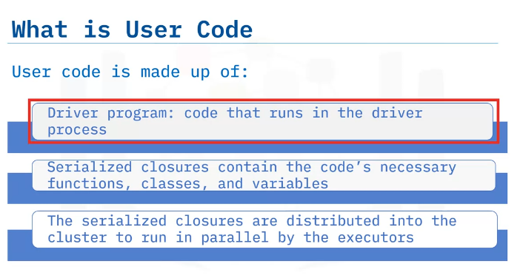
What is user code? User code is made up of the driver program, which runs in the driver process and the functions and variables serialized that the executor runs in parallel.
Both the driver and executor processes run the application user code of an application passed to the spark-submit script.
The user code in the driver creates the SparkContext and creates jobs based on operations to the DataFrames.
These DataFrame operations become serialized closures sent throughout the cluster and run-on executor processes as tasks.
The serialized closures contain the necessary functions, classes, and variables needed to run each task.

Slide 24
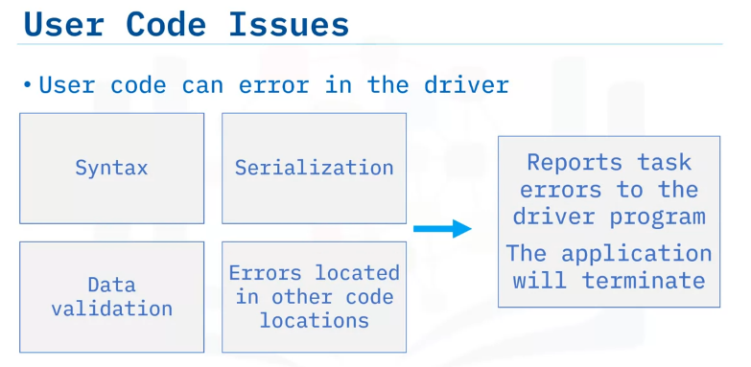
Spark usually immediately terminates when syntax, serialization, data validation, and other user errors occur.
Spark reports task errors to the driver and immediately cancels the related executor tasks, terminating the application.
For example, closures are cleaned before being serialized, flushing out most issues right away and ensuring that closures can be serialized and executed remotely.
User code serialized as a closure might not error until after the user code runs on another executor process.
These errors could be due to runtime calculations, network communication issues, or unexpected data issues.
If a task fails due to an error, Spark can attempt to rerun the task for a set number of retries.
If all attempts to run the task fail, Spark reports an error to the driver and the application is terminated.
The cause of an application failure can usually be found in the driver event log.

Slide 25
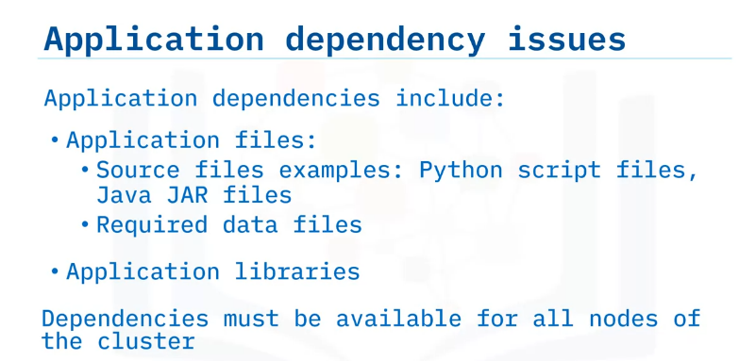
A Spark application can have many dependencies including application files such as Python script files, Java JAR files, and even required data files.
Applications also depends on the libraries used and their dependencies.
Dependencies must be made available on all nodes of the cluster, either by pre-installation or by including the dependencies in the spark-submit script bundled with the application, or as additional arguments.
For example, a task will error if a Python library is not installed in the Python environment of the executor process.
An even more subtle error can occur if a library is installed with different versions on executors that might have different APIs or produce unexpected results.
The best way to identify this type of issue is by examining the event log for stack trace errors that identify which libraries the application loaded

Slide 26
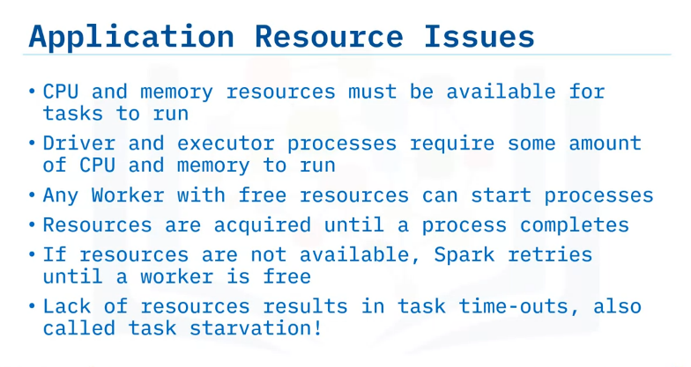
Application resources, such as CPU cores and memory, can become an issue if a task is in the scheduling queue and the available workers do not have enough available resources to run the tasks.
As a worker finishes a task, the CPU and memory in use are freed, allowing the scheduling of another task.
However, if the application asks for more resources that can ever become available, the tasks might never be run and eventually time out.
Similarly, suppose that the executors are running long tasks that never finish.
In that case, their resources never become available, which also causes future tasks never to run, resulting in a timeout error.
You can readily access these errors when you view the UI or event logs.

Slide 27
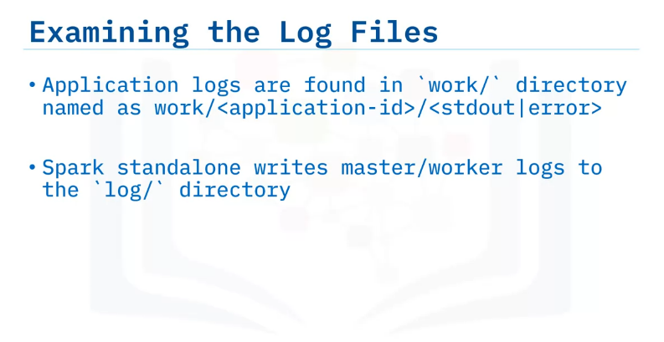
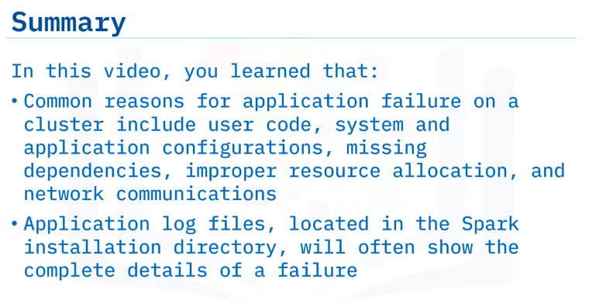
While the Application UI provides a great deal of information, viewing the log files provides details that give more insights into possible application failure causes.
You’ll find the application log files in the Spark installation directory, under `work/<application-id>/<stdout|error>,` where you will find one log file for `stdout` and one log file for `stderr` output.
The application-id is a unique ID that Spark assigns to each application.
These log files appear for each executor and driver process that the application runs.
Additionally, if you are running a Spark standalone cluster, the master and workers both output log files to the `log/` directory under the Spark installation directory from where they run.

Slide 28
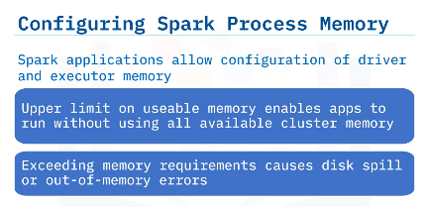
Understanding Memory Resources
Describe memory parameters.
Describe Spark memory management.
Describe Spark data persistence.
Explain how to set executor memory on submit.
Explain how to set memory for Spark Standalone memory and cores.
When running a Spark application, the driver and executor processes launch with an upper memory limit.
The upper memory limit enables a Spark application to run without using all the available cluster memory, but this limit also requires that the memory limits are set high enough to perform necessary tasks.
An application runs best when processes complete within the requested memory.
If the driver and executor processes exceed the memory requirements, this situation can result in poor performance with data spilling to disk or even out-of-memory errors.

Slide 29
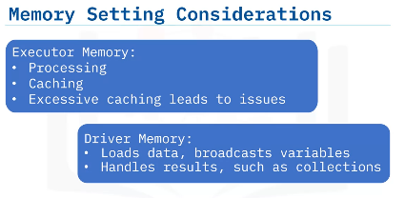
Let’s examine some memory setting considerations for both executors and drivers.
Executors use memory for processing and additional memory if caching is enabled.
However, excessive caching can lead to out-of-memory errors.
Collecting data as a result of operations will be done in the driver.
Driver memory loads the data, broadcasts variables, and handles results, such as collections.
Because large data sets can easily exceed the driver’s memory capacity, if collecting to the driver, filter the data and use a subset of the data.

Slide 30
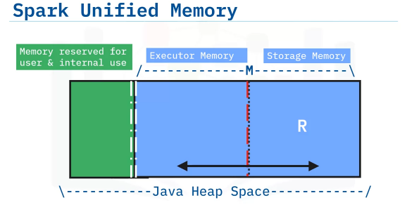
In Spark, executor memory and storage memory share a unified regions shown in this Java Heap Space in the space labeled M.
When no executor memory is used, storage can acquire all the available memory and vice versa.
Executor memory can evict storage memory if necessary, but only until total storage memory usage falls under a certain threshold.
In other words, R describes a subregion within M where cached blocks are never evicted.
Storage is not allowed to evict executor memory due to complexities in implementation.
This design ensures several preferable properties.
First, applications that do not use caching can use the entire space for executor memory, obviating unnecessary disk spills.
Second, applications that do use caching can reserve a minimum storage space, the area labeled R, where their data blocks are immune to being evicted.
Lastly, this approach provides reasonable out-of-the-box performance for a variety of workloads without requiring user expertise of how memory is divided internally.

Slide 31
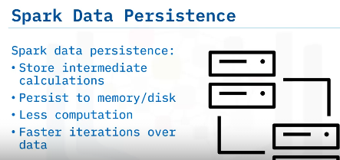
Next, let’s explore data persistence in Spark.
Data persistence, or caching data, in Spark means being able to store intermediate calculations for reuse.
By setting persistence in either or both memory and disk.
After the intermediate data is calculated to produce a new DataFrame, and if memory is cached, then any other operations on that DataFrame can reuse the same data, rather than re-loading data from the source and re-calculating all prior operations.
This capability is essential to speed machine learning workloads that often require many iterations over the same data set when training a model.

Slide 32
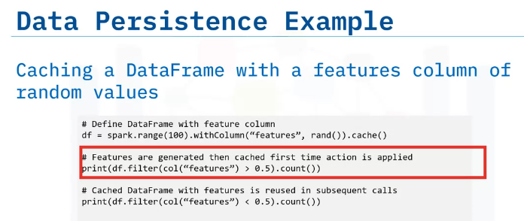
This sample PySpark code creates a DataFrame with column features consisting of random values.
After creating the DataFrame, the ‘cache()` method is called to mark the random values to cache in memory.
Caching the DataFrame here means that the application only needs to generate random features once.
At this point, the random values are not yet generated; caching is done lazily after computing the values.
In this example, the `count()` action is invoked on the DataFrame, which generates the values that are then stored in memory.
Subsequent DataFrame calls can use the cached values, which can save a great deal of computational time if the cost to recreate a DataFrame is high.
If this DataFrame is not cached, then different random features would be generated with each action on the DataFrame, because the function `rand()` is called each time.

Slide 33
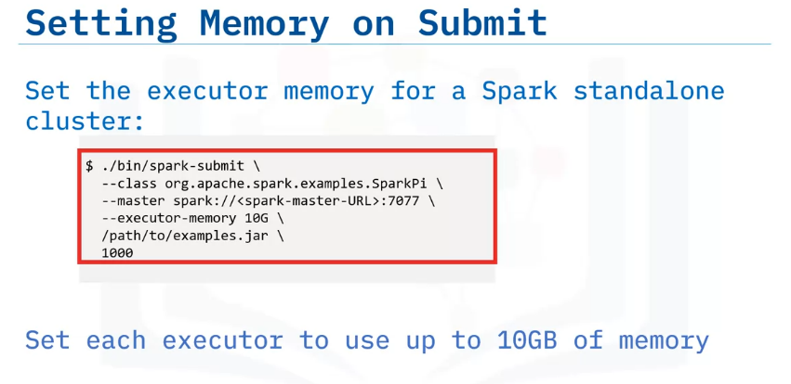
There are several ways to set the memory for executors in a cluster, such as setting a value in the properties file.
However, the more common practice is to specify a memory configuration when submitting the application to the cluster.
You can tailor memory so that each application has enough memory to run effectively but does not use all available memory in the executor.
This example configures the application to run on a Spark standalone cluster and reserves ten gibibytes per executor when running tasks.

Slide 34
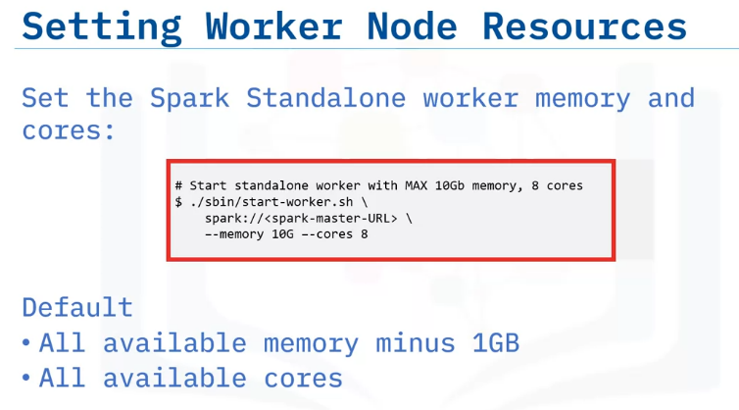
If using the Spark Standalone cluster to manage and start a worker manually, you can specify the total memory and CPU cores that the application can use.
These specifications determine the resources available when workers start the executors.
Avoid assigning more resources than are available on the physical machine.
For instance, if the machine has a CPU with eight cores and the worker starts with 16 cores, too many threads might run simultaneously and cause performance degradation.
You can tailor memory so that each application has enough memory to run effectively but does not use all available memory in the executor.
The default configuration is to use all available memory minus 1giigabyte for all available cores.

Slide 35
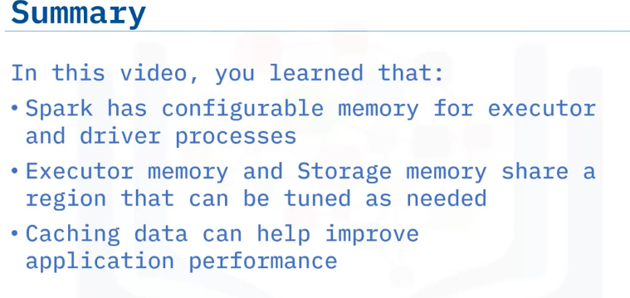

Slide 36
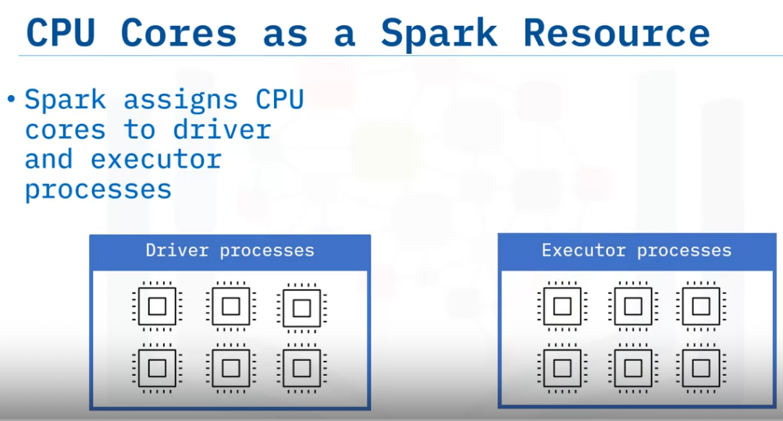
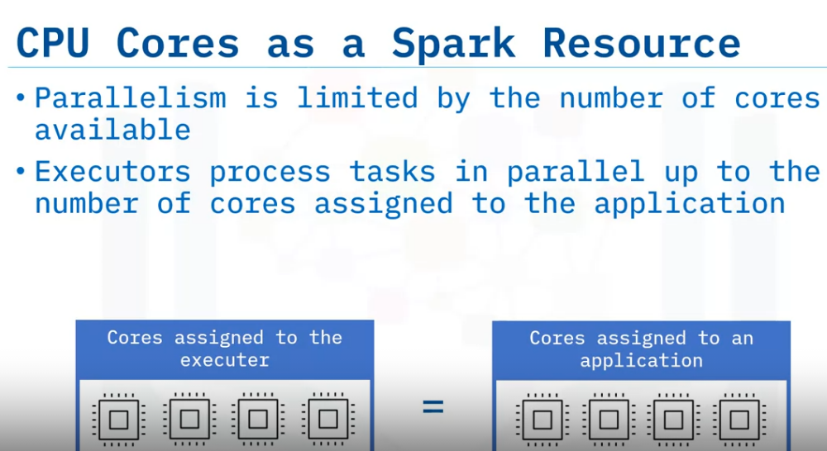
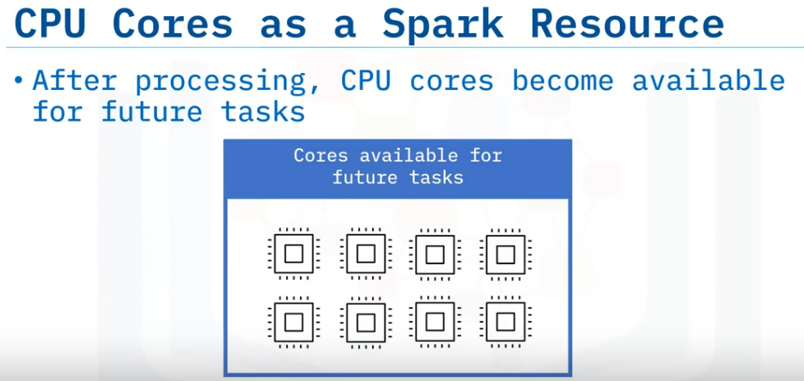
Understanding Processor Resources
Explain how Apache Spark uses processor cores.
Describe how to use Spark to configure cores for an application.
Just as with memory, CPU cores are a resource assigned to both the driver and executor processes.
An executor can process tasks in parallel only up to the number of cores assigned to the application.
Once the application tasks finish processing, the cores no longer in use return to the available pool.

Slide 37
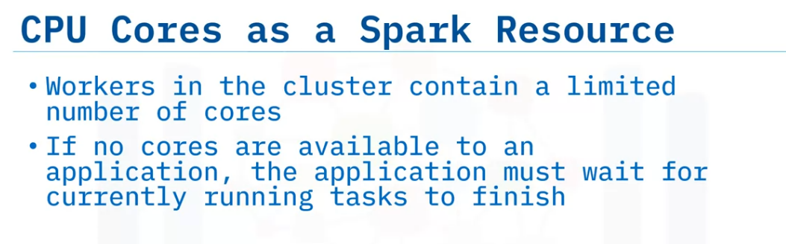
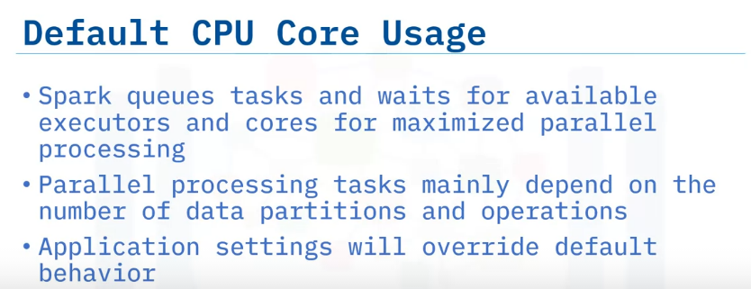
The workers in the cluster contain a limited number of cores.
If no cores are available to an application, the application must wait for currently running tasks to finish.
When Spark launches an application and creates tasks, Spark places those tasks in a scheduling queue.
Spark assigns tasks to any available executor.
The default behavior is for each task that is ready, to be scheduled to an executor with available cores to maximize parallelism.
Any remaining tasks will have to wait in the queue until more cores become available.
If you provided specific settings for the number of cores, such as configuring how many cores the executor uses, the application overrides the default behavior.

Slide 38
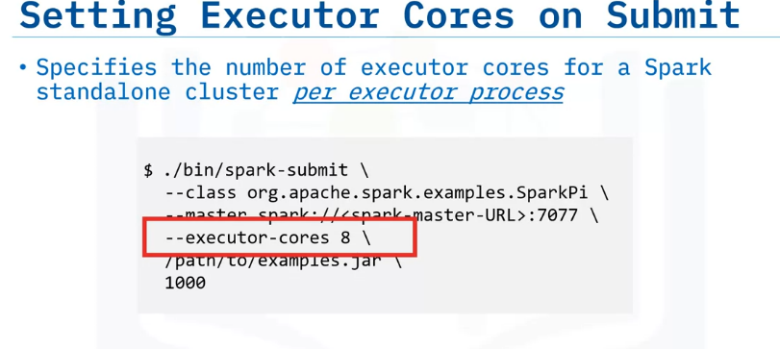
To configure executor cores on application submission, use the argument `- - executor-cores` followed by the specific number of cores required for the application tasks to run on an executor.
As always, if the executor does not have the required number of cores available, tasks do not start until the specified number of cores are free or another executor becomes available.
Alternatively, the argument `- -total-executor-cores` followed by a number is the total amount of cores throughout the cluster to use for the application, not per executor process.
Tasks will be scheduled to executors whenever they have a free core, until the total number of cores reaches the specified value.

Slide 39
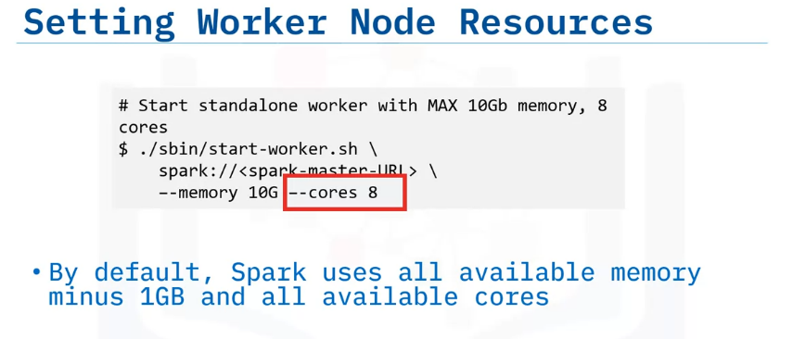
When starting a worker manually in a Spark standalone cluster, you can specify the number of cores the application uses by using the argument `- - cores` followed by the number of cores.
Spark’s default behavior is to use all available cores.
A common practice is to start one worker per node, which under default behavior, allows the worker to create one executor process with exactly the same number of threads as cores available to run tasks.
If another process is running on the same machine as the worker, such as the master, then a good practice is to apply these settings to reduce the number of cores available to the worker.
Specifying the total number of CPU cores can reserve processing time available for the master process so essential operations are not blocked and time out.

Slide 40
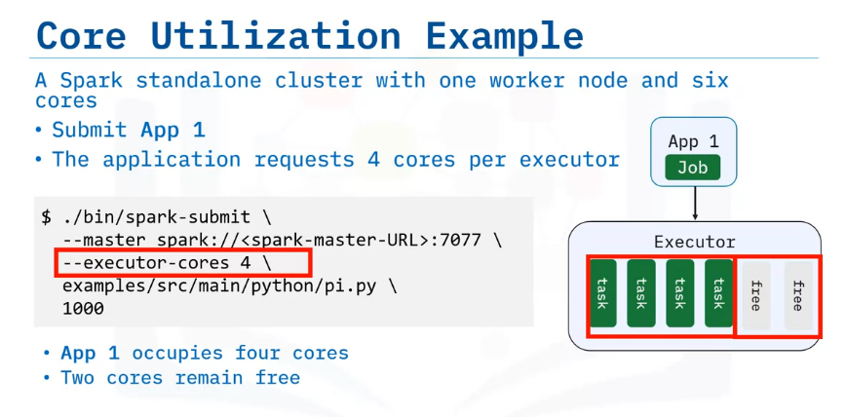
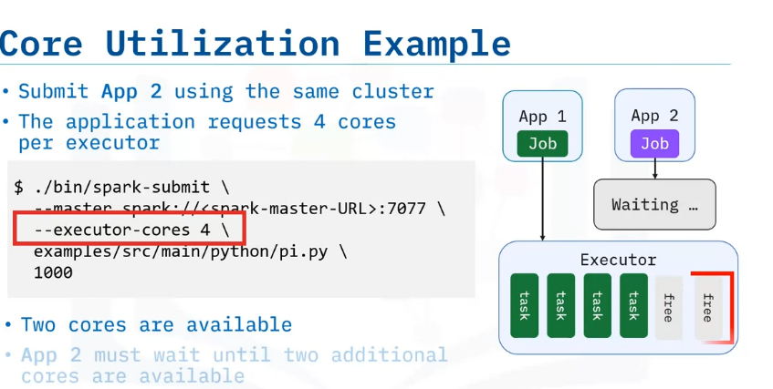
Let’s look at an example that uses a small standalone cluster with one worker node and six cores.
This example uses two identical applications submitted to the same cluster in overlapping time, one right after the other.
The first application is submitted to the cluster and requests four cores per executor.
The executor is currently idle with six cores available.
The first four tasks of the application are then scheduled to the executor and begin to run.
Two cores of the executor remain available.
While the first application is running, the second application is submitted.
The second application also requests 4 cores from the executor.
Because tasks that belong to the first application are still running and are using 4 cores, only 2 cores are available.
Therefore, the second application must wait until the executor has at least four cores available.
As soon as any two tasks from the first application complete and four cores become available, the second application can begin.

Slide 41
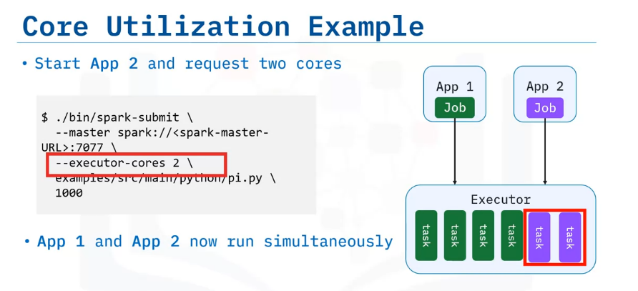
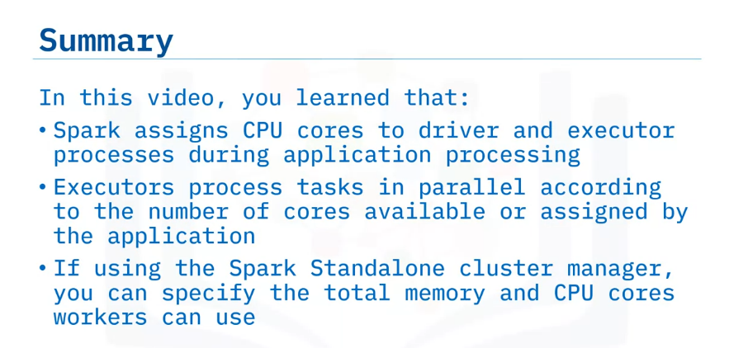
What if you start the second application and request only two cores to run two tasks?
Using this scenario, you can submit a second application, and two tasks immediately start.
However, the second application might take longer to finish because of running only two tasks at a time.
Maximizing Spark application performance can be a tricky balance between configuration of application workloads and cluster resources and requires careful tuning of both the application and the clusters.

Slide 42
Summary & Highlights
In this module you learned that:
To connect to the Apache Spark user interface web server, start your application and connect to the application UI using the following URL: http://<driver-node>:4040
The Spark application UI centralizes critical information, including status information into the Jobs, Stages, Storage, Environment and Executors tabbed regions. You can quickly identify failures, then drill down to the lowest levels of the application to discover their root causes. If the application runs SQL queries, select the SQL tab and the Description hyperlink to display the query’s details.
The Spark application workflow includes jobs created by the Spark Context in the driver program, jobs in progress running as tasks in the executors, and completed jobs transferring results back to the driver or writing to disk.
Common reasons for application failure on a cluster include user code, system and application configurations, missing dependencies, improper resource allocation, and network communications. Application log files, located in the Spark installation directory, will often show the complete details of a failure.
User code specific errors include syntax, serialization, data validation. Related errors can happen outside the code If a task fails due to an error, Spark can attempt to rerun tasks for a set number of retries. If all attempts to run a task fail, Spark reports an error to the driver and terminates the application. The cause of an application failure can usually be found in the driver event log.
Spark enables configurable memory for executor and driver processes. Executor memory and Storage memory share a region that can be tuned.
Setting data persistence by caching data is one technique used to improve application performance.

Slide 43
The following code example illustrates configuration of executor memory on submit for a Spark Standalone cluster: $ ./bin/spark-submit \ --class org.apache.spark.examples.SparkPi \ --master spark://<spark-master-URL>:7077 \ --executor-memory 10G \ /path/to/examples.jar \1000
The following code example illustrates setting Spark Standalone worker memory and core parameters: # Start standalone worker with MAX 10Gb memory, 8 cores $ ./sbin/start-worker.sh \ spark://<spark-master-URL> \ –-memory 10G –-cores 8
Spark assigns processor cores to driver and executor processes during application processing. Executors process tasks in parallel according to the number of cores available or as assigned by the application.
You can apply the argument ‘--executor-cores 8 \’ to set executor cores on submit per executor. This example specifies eight cores.
You can specify the executor cores for a Spark standalone cluster for the application using the argument ‘‘--total-executor-cores 50’ followed by the number of cores for the application. This example specifies 50 cores.
When starting a worker manually in a Spark standalone cluster, you can specify the number of cores the application uses by using the argument ‘--cores‘ followed by the number of cores. Spark’s default behavior is to use all available cores.

